Slide 1
Accessible Documents with MS Word
Think accessible first!

Slide 2
Access in Word
Documents
Logical structure
Clear components
Good color contrast
Graphics
Briefly described

Slide 3
Tips
Show hidden: ON (Alt + Shift + *)
Selecting
Rulers
Columns
Views

Slide 4
Four Simple Steps in Word
Links: Name links logically
Images: Add alt text
Picture descriptions
Styles: Use templates and styles
Tables: Mark the header row in tables
THEN make it into a PDF

Slide 5
Helpful Acronym
Use this “colored” LIST for access!
Links
Images
Structure
Table
And watch your color contrast!

Slide 6
L is for Links
Instead of …
Click here for document X
Use the name or description as the hyperlink
Document X has the information you need

Slide 7
Benefits
Benefit for you
You don’t loose connection with your materials when you make edits
Linking to documents and learning objects by their names allows you to keep track of them easily!
Benefit for others
What you get when you click is clear
Screen reader users can use a “links list”

Slide 8
How to Create a Link
Select the text for the hyperlink’s name
Right-click
Choose “Hyperlink…”
Browse to the object you want to link

Slide 9
Checklist
√ Links

Slide 10
I is for Images
Add very brief text description
If graphic is simply decoration, wait and mark it as “decorative” in Adobe Acrobat Pro
If graphic is informative, describe as succinctly as possible

Slide 11
Benefits
Benefits for you
Requires “out of the box” thinking
Text becomes searchable online
Benefits for others
Text appears on mouse-over, clarifying purpose of graphic
Provides access for nonvisual users
Higher “hit” on Google

Slide 12
How to Create Alt Text
Right click on graphic
“Format Picture”
“Alt Text”
Enter text in “description”

Slide 13
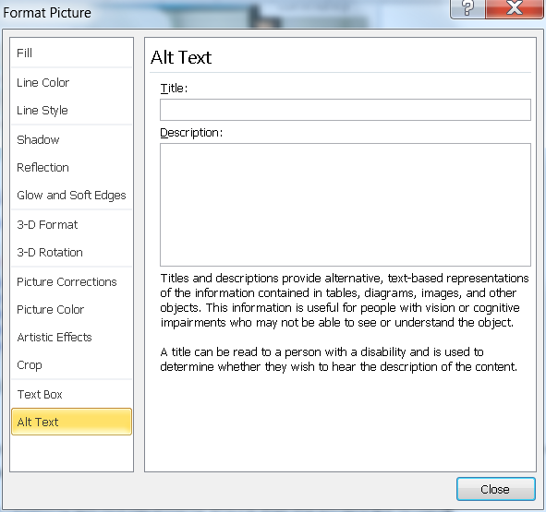
Alt Text
Right click on picture
At bottom of window, choose Alt Text
Note: Put the alt text where it says “Description”

Slide 14
Describing Graphics
When determining the purpose, always consider the context in which the graphic is being shown.
The same graphic may have a different purpose in a different context.
Sometimes decoration
Sometimes informational
Sometimes an activity (graphs, charts, etc.)

Slide 15
Informational
If information is being conveyed, then consider…
What is the information being presented in the graphic?
Is that information already conveyed in the text?
How can I describe the graphic in as few words as possible?

Slide 16
Decoration
Does it even need to be described?
If not…
Null text it or “_” on the Web
Mark as “decorative” in Adobe Pro
If yes, how much description? Usually very little!

Slide 17
Activity
If the student must do something with a graphic, make sure the description does not give away the answer to a question

Slide 18
First Question to Ask
What is the purpose? Information or Decoration or Activity?
How much is the purpose of the graphic informational?
How much decoration?
Do we have to do something with it?

Slide 19
Exercise 1
In a book about health, this full-page photo appears at the beginning of a chapter on nutrition:

Slide 20
Possible Alt Text
The photo is mostly decorative.
It is simply illustrating the theme of the book.
Keep the description simple:
People biking
Cyclists

Slide 21
Logo Example 1
Kansas City Kansas Community College
Presents an Evening of Jazz
Come join us for two hours of wonderful jazz by the lake. …

Slide 22
Possible Alt Text
The logo is mostly decorative.
Logo is branding for school, but in this context is essentially decorative from the end-user’s viewpoint.
Since the graphic is basically decorative, keep it simple.
College logo
KCKCC logo

Slide 23
Logo Example 2
In marketing your business, the design of a logo can make a big impression or can be a waste of money. The logo needs to be attractive but not dominate other information presented along with the logo. In the example below, what catches your attention?

Slide 24
Possible Alt Text
The logo is informational.
In this case, the same logo is a specific example and requires a more lengthy description.
Focus on what the student needs to know:
Interlocking blue K and red C on left with the words “Making Life Better” in red above the college name in black blocked and underlined with a blue line.
Notes:
Robert: two opposite interns
Gaeir: When a graphic is part of an exercise, a lengthier description is required.

Slide 25
No Single Right Way
There is not only one way to describe graphics.
Just remember…
Keep context in mind
Ask yourself: Is this something the person really needs to hear?

Slide 26
Checklist
√ Links
√ Images

Slide 27
S is for Styles
Use styles
Headings
Lists / bulleted lists / numbered lists
Use columns if needed
DO NOT use text boxes

Slide 28
Benefits
Benefits for you
Allows easy changing and editing
Improves document navigation
Can use “outline” view to rearrange sections
Automatic table of contents
Benefits for others
Improves document navigation for all—headings useable with screen readers

Slide 29
In General
Font size and readability
12 point is good
Avoid fonts that will be difficult to read online
Color contrast
Be aware of color!
Avoid white text on light background; avoid black text on dark background
Avoid using enter key for spacing

Slide 30
Selecting Text
Double click
Triple click
Shift + arrow keys
Shift + home/end
Shift + page up/page down
"shift-click" technique

Slide 31
Keyboard Shortcuts
Heading One = Ctrl + Alt + 1
Heading Two = Ctrl + Alt + 2
Heading Three = Ctrl + Alt + 3
Remove manual formatting = Ctrl + Spacebar
Normal style = Ctrl + Shift + N
Change case = Shift + F3

Slide 32
Outline/Draft Styles
File > Options > Advanced > Display
Style area pane
Set to > 0 (e.g., .75)

Slide 33
Modifying Styles
Styles can be modified in MS Word to change spacing, fonts, etc.
Best NOT to modify Normal Style
Use Body Text if you wish to make changes
Styles pane: Ctrl + Alt + Shift + S

Slide 34
Checklist
√ Links
√ Images
√ Styles

Slide 35
T is for Table
Mark the header row in your tables
Word calls this “Repeat as header row at top of every page” or just “Repeat Header Rows”
Note: If you have column headers (i.e., header in first column), that will need to be marked in Adobe Acrobat Pro

Slide 36
Benefits
Benefits for you
Always see header row, even across multiple pages
Lessens reformatting/editing issues
Benefits to others
Screen reader users will be able to hear the header text repeated as needed
Users of large print will still see header row when enlarging text

Slide 37
Checklist
√ Links
√ Images
√ Styles
√ Tables
And you’re done!

Slide 38
Accessible Documents
For maximum accessibility include both the PDF and the Word document online
If concerned about security with Word, can apply permissions

Slide 39
Checking Your Word…er…Work
Accessibility Checkers Can Help

Slide 40
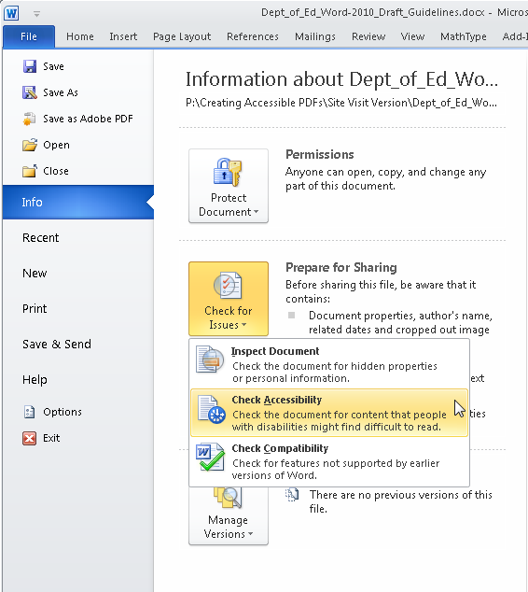
MS Word Built-in Checker

Slide 41
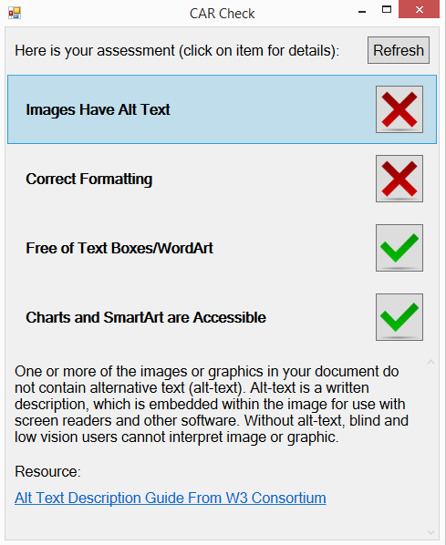
CAR Check
Central Access Reader (CAR) from Central Washington University
http://www.cwu.edu/central-access/carcheck

Slide 42
Color Contrast
Color Contrast Analyzer (CCA)
http://www.paciellogroup.com/resources/contrastanalyser/
Can download checker for free
Windows or Mac version

Slide 43
Accessible Documents
For maximum accessibility include both the PDF and the Word document online
PDF and RTF

Slide 44
Thank you!
Gaeir (rhymes with “fire”) Dietrich
gdietrich@htctu.net
408-996-6047

